Slide 1

TOP BIKE
Presented by gabriel molina

Slide 2
This Feasibility Study Report was prepared for the TopBike Case to evaluate potential remedial alternatives for further expansion of the current brick and the mortar store. Implementing this new system, the employees will be able to keep track of the inventory and decrease the time and effort spent on the organization TopBike. The specific functionalities that the new system should have are:
Organize in-store sales
Purchase items from the suppliers
Establish a customer database
Organize employee payroll into an employee database
Search for items in the inventory database
Establish a work order database

Slide 3
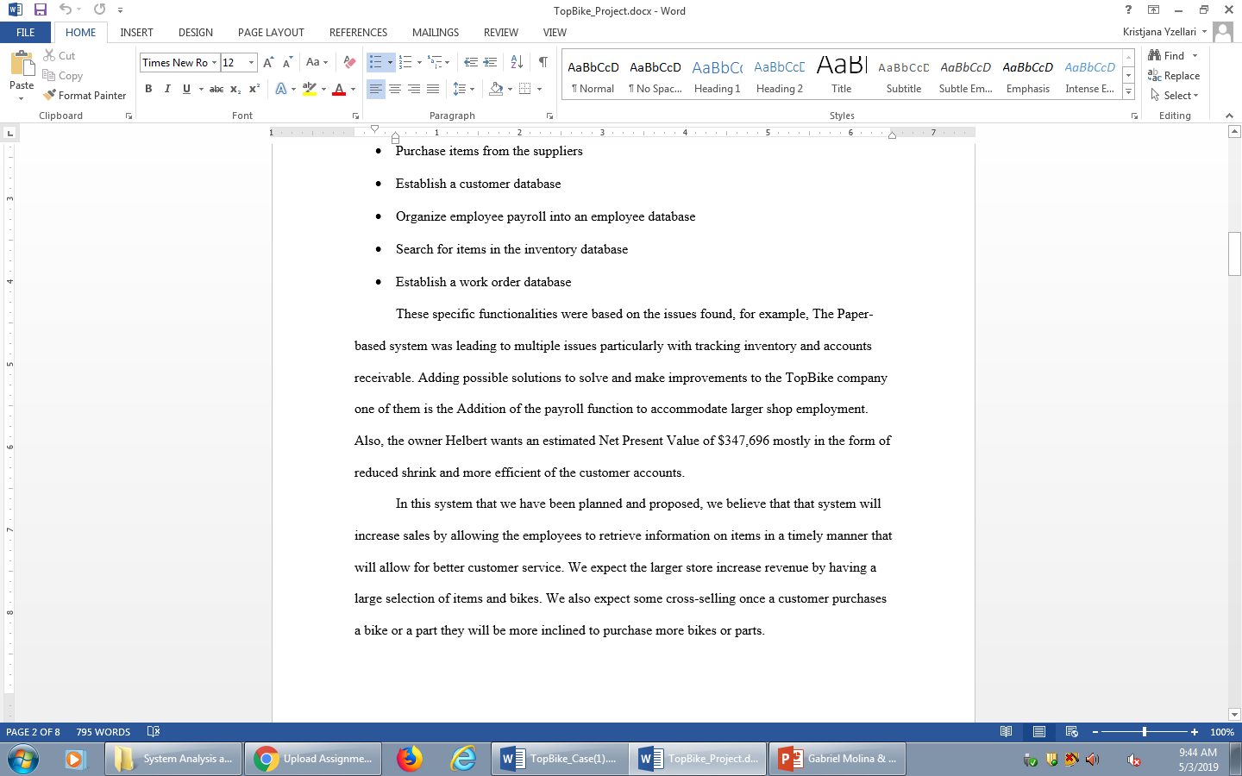

Slide 4
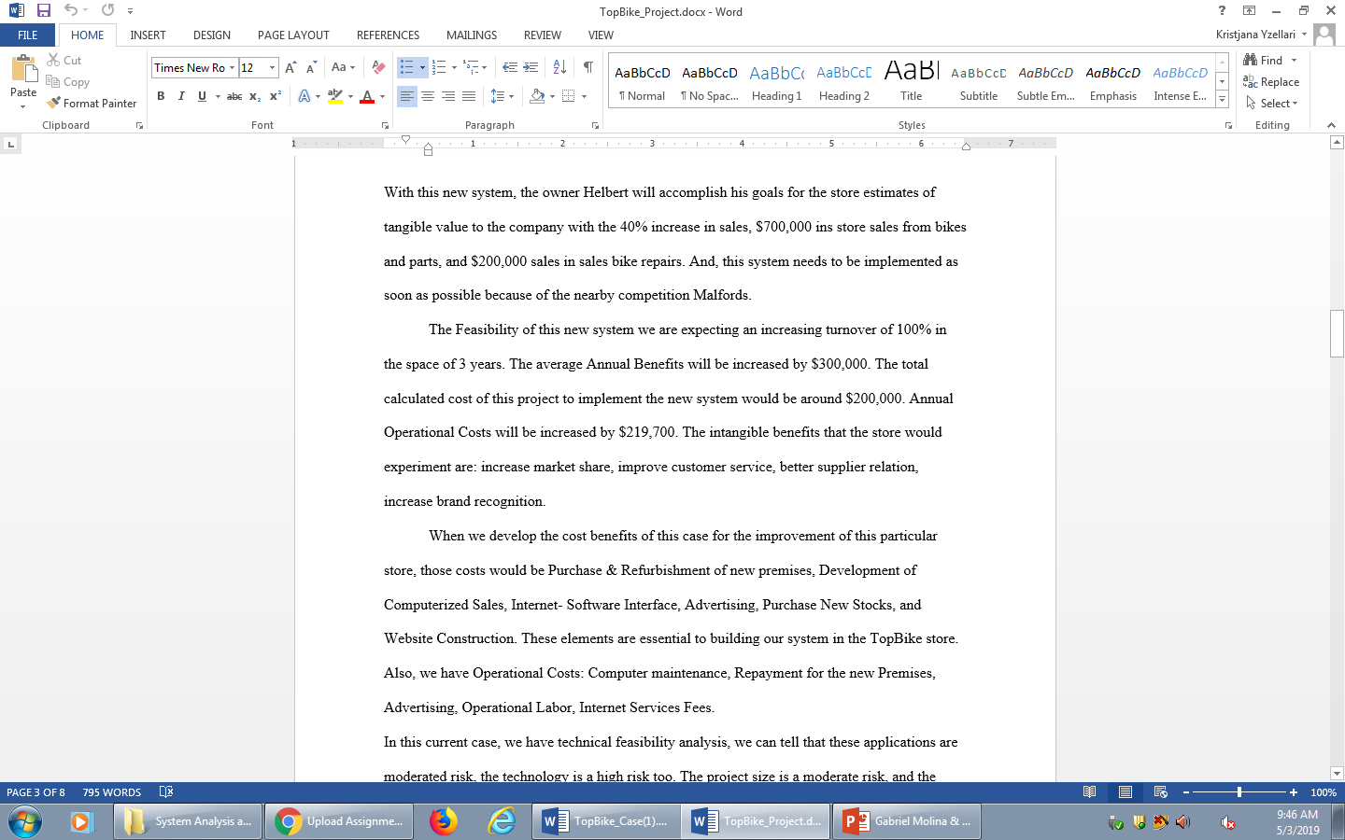

Slide 5

Top BIKE Levels
Contex Diagram
Level 1
Level II
Logical Data Structure Database

Slide 6
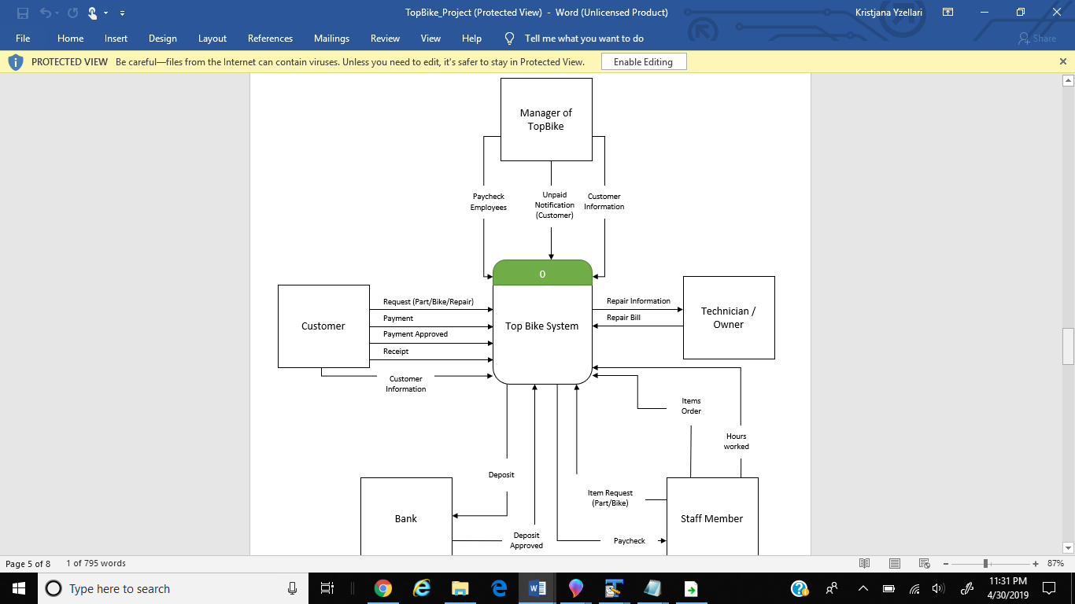

Slide 7
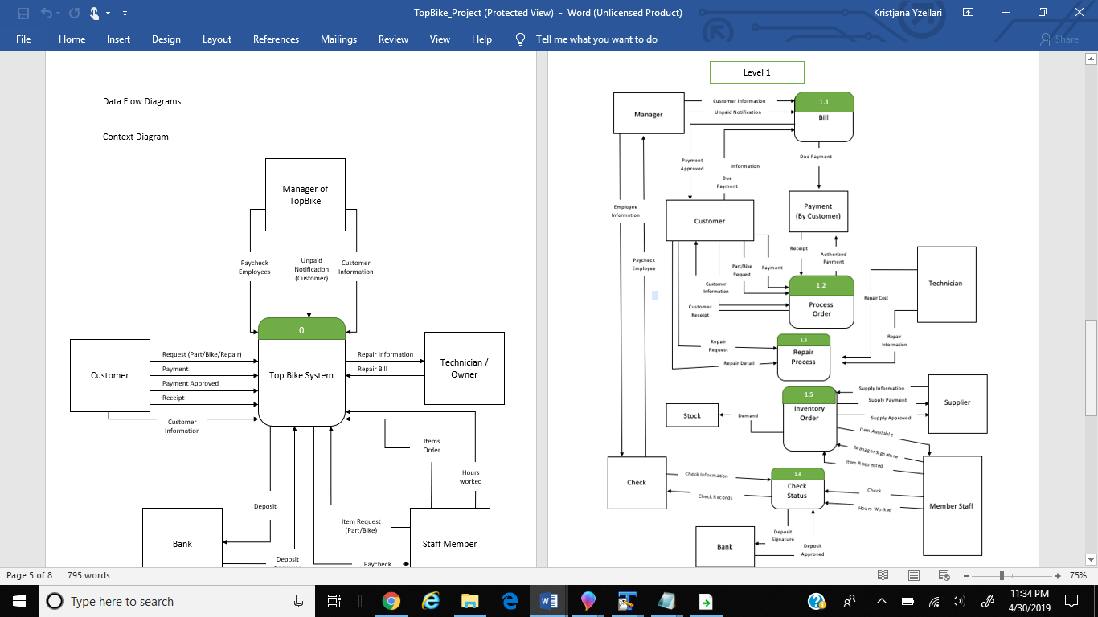

Slide 8
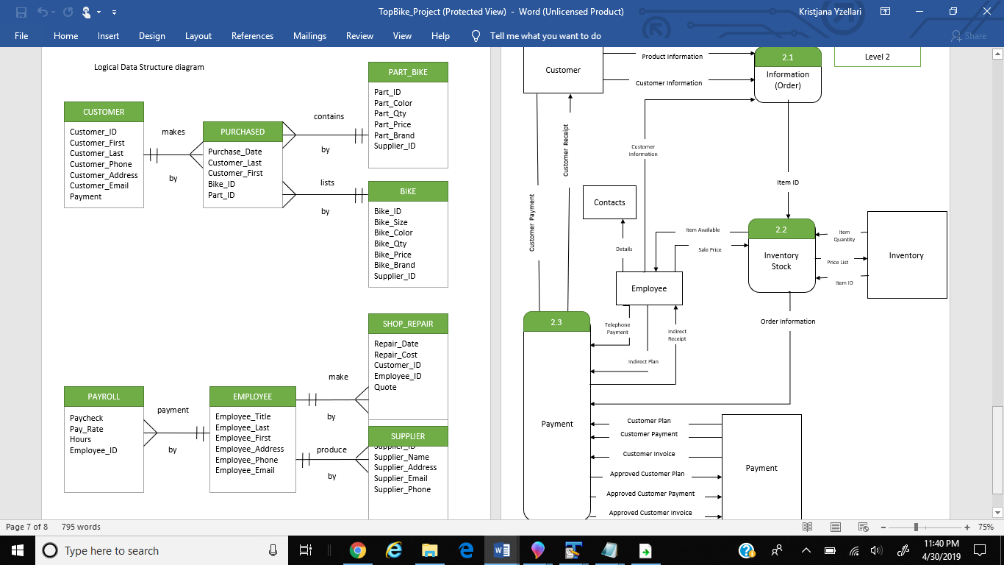

Slide 9
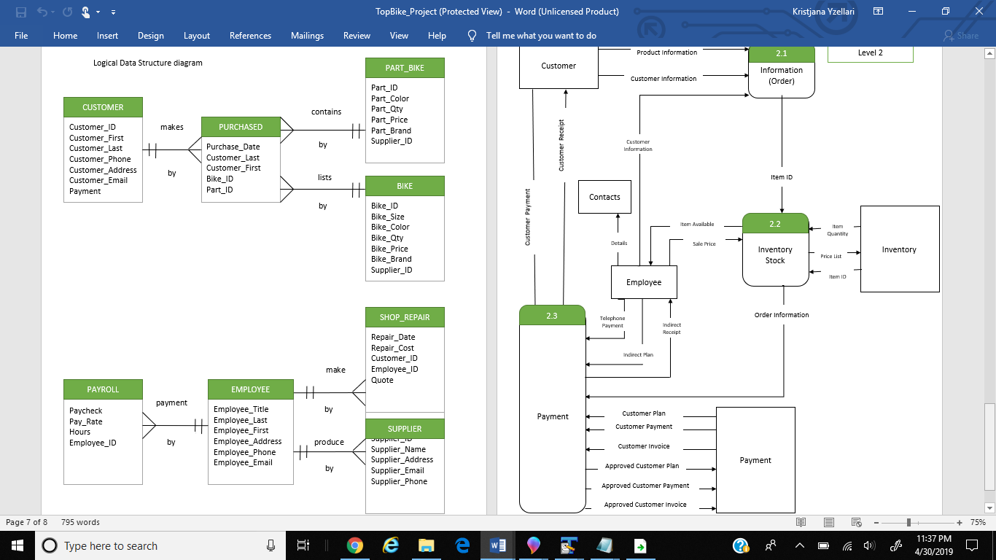

Slide 10
THANK YOU!
System aNALYSIS AND dESIGN

